Slide 1

Green Pace
Security Policy Presentation
Developer: Kyle Lund

Slide 2

OVERVIEW: DEFENSE IN DEPTH
The information security strategy known as "defense in depth" involves layering safety procedures deliberately and carefully to increase protection against potential risks and system weaknesses.

Slide 3
10 PRINCIPLES
Validate Input Data
Heed Compiler Warnings
Architect and Design for Security Policies
Keep It Simple
Default Deny
Adhere to the Principle of Least Privilege
Sanitize Data Sent to Other Systems
Practice Defense in Depth
Use Effective Quality Assurance Techniques
Adopt a Secure Coding Standard

Slide 4
CODING STANDARDS
Priority
STD-002-CPP HIGH(12)
STD-003-CPP HIGH(18)
STD-004-CPP HIGH(12)
STD-005-CPP HIGH(18)
STD-010-CPP MEDIUM(6)
STD-009-CPP MEDIUM(6)
STD-006-CPP LOW(1)
STD-007-CPP LOW(4)
STD-008-CPP LOW(4)
STD-001-CPP LOW(3)
Do not read uninitialized memory
Do not attempt to create a std::string from a null pointer
Prevent SQL injection
Do not access freed memory
Do not access an object outside of its lifetime
Use valid iterator ranges
Use a static assertion to test the value of a constant expression
Do not abruptly terminate the program
Write constructor member initializers in the canonical order
Obey the one-definition rule

Slide 5
THREATS MATRIX
Likely STD-003-CPP STD-005-CPP STD-009-CPP | Priority STD-003-CPP
Low priority STD-004-CPP STD-010-CPP STD-007-CPP | Unlikely STD-008-CPP STD-006-CPP STD-001-CPP

Slide 6
ENCRYPTION POLICIES
Encryption in Rest - Protects stored data, Hard drives, phones, Computers, and cloud assets.
Encryption in Flight – Protecting data that is moving such as data moving between devices in a network and outside the network.
Encryption in Use – Protects data that is being edited, created, and in other definitions of being in use. Protection should be implemented before use.

Slide 7
TRIPLE-A POLICIES
Authentication – The act of confirming one’s identity, ensuring the person is who they say they are.
Authorization – Specifies the access level and privileges a user can and cannot have access too.
Accounting – The act of keeping track of a systems activity while it is being interacted with. This includes timestamps, accessed resources, and logged users. This creates a breadcrumb trail of activity to follow.

Slide 8
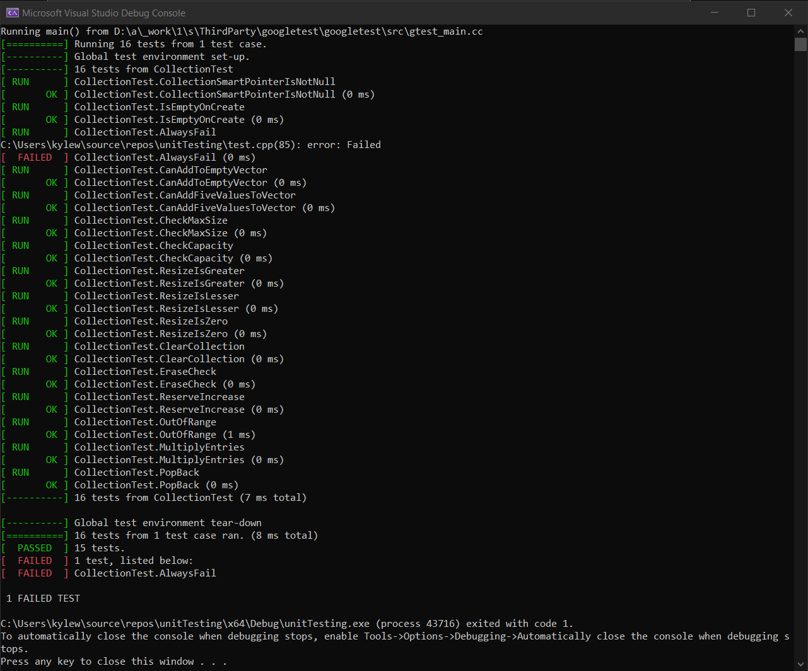
Unit Testing
Unit Testing based on Google’s Unit Testing Framework

Slide 9

AUTOMATION SUMMARY
Automation will be used to ensure compliance and enforcement of the policies' specified requirements. Within the current DevOps, automation will enforce standards in several areas. We could automate penetration tests throughout the production stage.

Slide 10
TOOLS
The DevSecOps Pipeline refers to integrating security into your software development life cycle
Software development life cycles (SDLCs) are being expanded upon by DevSecOps, which focuses on security standards from the beginning. Ensuring smooth operation from the designing, construction, and testing stages to production maintenance requires adherence to a secure, consistent policy.
The "Verify and Test" stage of the procedure will make use of several tools, such as Clang and Astree. Using external tools will assist in ensuring that all code complies with security regulations, detecting vulnerabilities in dependencies, and verifying code functionality.

Slide 11
RISKS AND BENEFITS
Risks of Waiting:
Potential harm to data
Potential harm to consumer trust
Financial costs
Potential future damages from attacks
Benefits:
Mitigate possible damages
Prevent threats
Create a structured and consistent security system
Potential money saved in case of a security issue.
Conclusion: There are considerably more benefits than drawbacks to taking early action and putting automation and safety measures in place. Imagine a hacker who manages to get past security measures to steal user data. Any upfront costs are outweighed by the possible loss of value in the form of trust or compensation.

Slide 12
RECOMMENDATIONS
A strong foundation is provided by policy. It should be updated and reviewed on a regular basis, or whenever gaps are found.
Annual audits by a third-party, such a white hat security company, will help in testing security in real-world scenarios and identifying any weaknesses.
Keep to Triple A policies in a strict manner

Slide 13
CONCLUSIONS
Focus should be made to the use of strings, buffers, and memory management, especially when working in C++, even though all standards should be implemented to further strengthen the security of both the systems and applications.
It's also crucial to consider log files, or the Triple-A Framework's "Accounting" section. Attacks will occur, and our response will be solely based on the information we are able to obtain regarding the vulnerability.

Slide 14
REFERENCES
Nangare, S. (2019, October 10). DevSecOps pipelines and tools: What you need to know. Opensource.com.
https://opensource.com/article/19/10/devsecops-pipeline-and-tools
Authentication, Authorization, Accounting and Identity Management. (2018, April 3). CCSI.
https://www.ccsinet.com/blog/aaa-identity-management/
Argintaru, D. (2021). Data Encryption: How to Protect Data in Transit, Data in Use and Data at Rest. Mimecast.com.
https://www.mimecast.com/blog/data-in-transit-vs-motion-vs-rest/

